Slide 1
Machine Learning

Slide 2
Machine Learning
Machine learning (ML) is a branch of artificial intelligence (AI) and computer science that focuses on the using data and algorithms to enable AI to imitate the way that humans learn, gradually improving its accuracy.

Slide 3
Machine Learning Development Lifecycle (MLDLC)
Framing The Problem
What is problem, Customers, pricing , team, whether supervised or unsupervised, offline or batch, where data comes from
Gathering Data
CSV, Web Scraping, Datasets, API, Database (Data Warehouse), Spark Clusters (For big data)
Data Preprocessing
Removing duplicates, Missing Values, Outliers, Scale (standardization)
Exploratory Data Analysis
Visualization (graphs), Univariate analysis, bivariate analysis, multivariate analysis, Outliner detection, Imbalance data (one type of data is more)

Slide 4
Machine Learning Development Lifecycle (MLDLC)
Feature Engineering and Selection
Outlining only the important feature that actually impact th output.
Model Training Evaluation and Selection
Check algorithms and gather data to choose which algorithm needs to be deployed.
Evaluation Metrics.
Model selection parameters (settings) are tuned. Ensemble Learning Combining multiple machine learning algorithm to create a powerful algorithm.
Model Deployment
Deploy model on a platform such as website by creating API.

Slide 5
Machine Learning Development Lifecycle (MLDLC)
Testing
AP Testing (How well model is performing) Different users to test model.
Optimize
Model Backup
Data Backup
Load Balancing

Slide 6
Types of Machine Learning
Supervised
Unsupervised
Semi Supervised
Reinforcement Learning

Slide 7
Supervised Learning
In Supervised Learning the model is trained on labeled data, where the input data is paired with the correct output.
Examples:
Regression: Predicting continuous values (e.g., house prices)
Classification: Predicting discrete values (e.g., email spam detection).

Slide 8
Algorithms in Supervised Learning
Linear Regression
Logistic Regression
Decision Trees
Random Forests
Support Vector Machines (SVM)
Neural Networks

Slide 9
Linear Regression
Linear regression is a supervised learning algorithm used to model the relationship between a dependent variable and one or more independent variables by fitting a linear equation to observed data.
Predict the value of a dependent variable based on the values of independent variables.

Slide 10
Simple Linear Regression
Simple linear regression is a method to predict a dependent variable (y) using one independent variable (x).
It consists of one input column (Independent) and one output column (Dependent).

Slide 11
Data Preprocessing
Feature Scaling
Normalization and Standarization

Slide 12
Simple Linear Regression
Mathematical Equation:
Equation: 𝑦=𝛽0+𝛽1𝑥+𝜖
y: Dependent variable (target)
x: Independent variable (feature)
𝛽o​ : Intercept
𝛽1​ : Slope (coefficient)
𝜖ϵ: Error term

Slide 13
Simple Linear Regression
Introduction and Data Loading
Code:
import matplotlib.pyplot as plt,
import pandas as pd,
import numpy as np,
df = pd.read_csv('placement.csv’),
df.head()
Explanation
Libraries Imported: matplotlib.pyplot, pandas, numpyData
Loading: Reads the placement.csv file into a DataFrame df
Preview Data: Displays the first few rows of the dataset with df.head()

Slide 14
Simple Linear Regression
Data Preparation
Code:
x = df.iloc[:, 0:1], y = df.iloc[:, -1]
Explanation:
Feature Selection: Selects the first column (CGPA) as the feature
Target Selection: Selects the last column (Package) as the target
Train-Test Split
Code:
from sklearn.model_selection import train_test_split,
x_train, x_test, y_train, y_test = train_test_split(x, y, train_size=0.8, random_state=2)
Explanation:
Splits the data into training (80%) and testing (20%) sets
Random State: Ensures reproducibility with random_state=2

Slide 15
Simple Linear Regression
Model Training
Code:
from sklearn.linear_model import LinearRegression,
lr = LinearRegression(),
lr.fit(x_train, y_train)
Explanation:
Trains the linear regression model.
Making Predictions
Code:
lr.predict(x_test.iloc[0].values.reshape(1, 1))
Explanation:
Makes a prediction for the first test sample after reshaping

Slide 16
Simple Linear Regression
Model Coefficients and Intercept
Code:
lr.coef_, lr.intercept_
Explanation:
Retrieves the model’s coefficients and intercept.
VisualizationCode:
plt.scatter(df['cgpa’],
df['package']),
plt.plot(x_test, lr.predict(x_test), color='red’),
plt.xlabel('CGPA’),
plt.ylabel('Package’),
plt.title('CGPA vs Package’),
plt.show()
Explanation:
Plots the data points and regression line with appropriate labels and title.

Slide 17
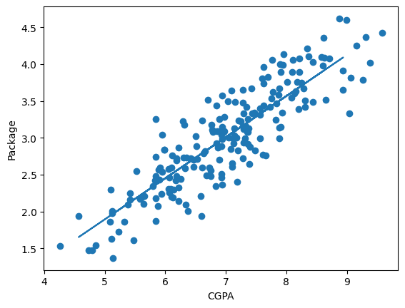
Simple Linear Regression

Slide 18
Multiple Linear Regression
Multiple Linear Regression uses two or more independent variables (x) to predict a dependent variable (y).
Model the linear relationship between multiple independent variables and a dependent variable.

Slide 19
Multiple Linear Regression
Mathematical Equation:
Equation: 𝑦=𝛽0+𝛽1𝑥1+ 𝛽2𝑥2 + ….. + 𝛽n𝑥n+ 𝜖
y: Dependent variable (target)
x1, x2, x3: Independent variable (feature)
𝛽o​ : Intercept
𝛽1, 𝛽2 , 𝛽3​ : Slope (coefficient)
𝜖ϵ: Error term

Slide 20
Multiple Linear Regression
Introduction and Data Loading
Code:
import matplotlib.pyplot as plt,
import pandas as pd,
import numpy as np,
df = pd.read_csv('placement.csv’),
df.head()
Explanation
Libraries Imported: matplotlib.pyplot, pandas, numpyData
Loading: Reads the placement.csv file into a DataFrame df
Preview Data: Displays the first few rows of the dataset with df.head()

Slide 21
Multiple Linear Regression
Data Preparation
Code:
x = df.iloc[:, 0:1], y = df.iloc[:, -1]
Explanation:
Feature Selection: Selects the first column (CGPA) as the feature
Target Selection: Selects the last column (Package) as the target
Train-Test Split
Code:
from sklearn.model_selection import train_test_split,
x_train, x_test, y_train, y_test = train_test_split(x, y, train_size=0.8, random_state=2)
Explanation:
Splits the data into training (80%) and testing (20%) sets
Random State: Ensures reproducibility with random_state=2

Slide 22
Multiple Linear Regression
Model Training
Code:
from sklearn.linear_model import LinearRegression,
lr = LinearRegression(),
lr.fit(x_train, y_train)
Explanation:
Trains the linear regression model.
Making Predictions
Code:
lr.predict(x_test.iloc[0].values.reshape(1, 1))
Explanation:
Makes a prediction for the first test sample after reshaping

Slide 23
Multiple Linear Regression
Model Coefficients and Intercept
Code:
lr.coef_, lr.intercept_
Explanation:
Retrieves the model’s coefficients and intercept.
VisualizationCode:
plt.scatter(df['cgpa’],
df['package']),
plt.plot(x_test, lr.predict(x_test), color='red’),
plt.xlabel('CGPA’),
plt.ylabel('Package’),
plt.title('CGPA vs Package’),
plt.show()
Explanation:
Plots the data points and regression line with appropriate labels and title.

Slide 24

Polynomial Regression
Polynomial Regression tries to fit non linear relationships between independent variable x and dependent variable y as $n$ degree polynomial.
Useful when relationships may be described as a curve.

Slide 25

Polynomial Regression
Equation: $y=β_{0}+β_{1}x+β_{2}x^{2}+…+β_{n}x^{n}+ε$
$y$ : Dependent variable (target)
$x$ : Independent variable (feature)
$β_{0},β_{1},…,β_{n}$ : Coefficients of polynomial terms
$ε$ : Error term

Slide 26
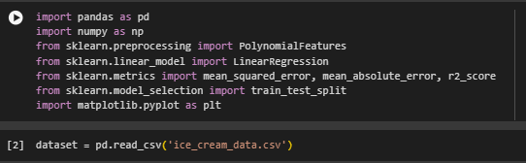
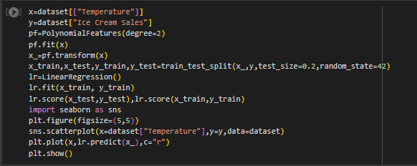
Polynomial Regression

Slide 27
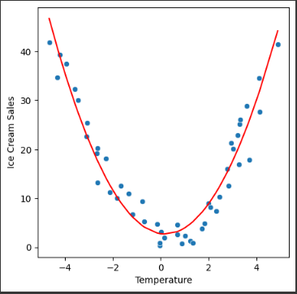
Polynomial Regression

Slide 28
Best Fit Line in Linear Regression
The best fit line, also known as the regression line, is the straight line that best represents the data on a scatter plot.
Scatter Plot: Visual representation of data points.
Regression Line: The line that minimizes the sum of the squared differences between observed and predicted values.

Slide 29

Regression Metrics
Metrics are used to evaluate the performance of a regression model.
Mean Absolute Error: The average absolute difference between predicted values and actual values.
Formula: MAE $=\frac{1}{n}∑_{i=1}^{n} \left|y_{i}−{\overset{ˆ}{y}}_{i}\right|$
Lower MAE better model performance.

Slide 30

Regression Metrics
Mean Squared Error: Average of square of errors
Formula: MAE $=\frac{1}{n}∑_{i=1}^{n} {(y_{i}−{\overset{ˆ}{y}}_{i})}^{2}$
Root Mean Squared Error: Square root of MSE
Formula: RMSE= $\sqrt{MSE}$

Slide 31
Cross Validation
A technique used in machine learning to evaluate the performance of a model on unseen data. It involves dividing the available data into multiple folds or subsets, using one of these folds as a validation set, and training the model on the remaining folds.

Slide 32

Cross Validation

Slide 33


Cross Validation

Slide 34
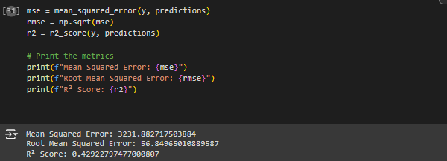
Cross Validation

Slide 35


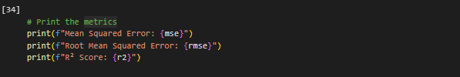
Cross Validation

Slide 36
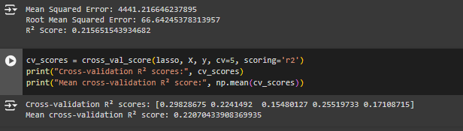
Cross Validation

Slide 37
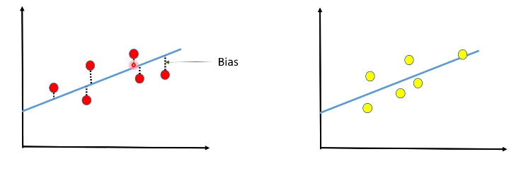
Bias
The difference between the average prediction of our model and the correct value that we are trying to predict.
High Bias and Low Bias

Slide 38
Types of Bias
Exclusion - it’s an instance of deleting important data that’s been deemed unimportant. It can also happen as a result of the systematic omission of certain data.
Recall – Occurs during data labeling. When you name types of data that are similar, in different ways, you get recall bias. As a result, accuracy suffers.
Sample – Sample bias or selection bias occurs when the realities of the environment in which an ML model will run do not reflect the dataset
Association – Association bias happens when a cultural bias is reinforced or multiplied by an ML model.

Slide 39
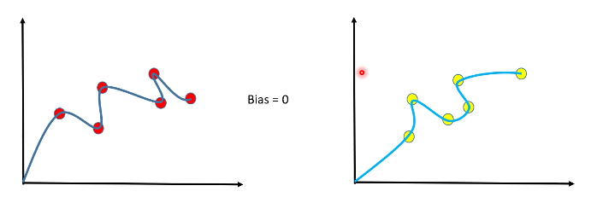
Variance
The amount that the estimate of the target function will change if different training data was used.

Slide 40
Techniques for Good Bias Variance Tradeoff
Good Model Selection
Regularization (reduce the values of coefficients)
Dimensionality Reduction (reducing features)

Slide 41

Loss Function
The difference between the predicted outputs of a machine learning algorithm and the actual target values.
Helps to determine which model performs better and which parameters perform better.

Slide 42

Loss Function
n = total number of values
$Y_{i}$ = true value
${\hat{Y}}_{i}$ = Predicted value
Square taken so that positive and negative errors do not cancel out each other

Slide 43
Overfitting
When a model learns the detail and noise in the training dataset to the extent that it negatively impacts the performance of model.
Overtrains on training data
High Training data Accuracy and low test data accuracy
Low Bias and High Variance

Slide 44
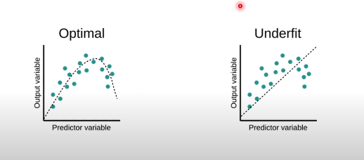
Underfitting
When a model doesn’t learn enough from data. Model cannot capture underlying trend of data.
Training data accuracy low
High bias and Low Varience

Slide 45
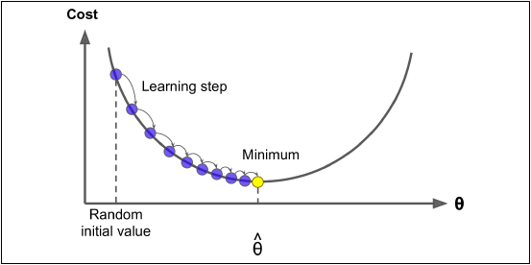
Gradient Descent
Gradient Descent change parameters iteratively to minimize the cost function. The idea is to take steps opposite to the direction of gradient.

Slide 46

Gradient Descent
Steps to calculate Gradient Descent:
Select Initial values of weight and bias
Compute predictions of data using formula:
$${\hat{y}}_{i}=wx_{i}+b$$
Compute loss:
$$L=\sum_{ⅈ=1}^{n}{{(y_{i}−{\hat{y}}_{i})}^{2}}$$
Compute Gradients:
$$\begin{matrix} & \frac{∂L}{∂w}=−\frac{2}{n}∑_{i=1}^{n} \left(y_{i}−{\overset{ˆ}{y}}_{i}\right)x_{i} \\ & \frac{∂L}{∂b}=−\frac{2}{n}∑_{i=1}^{n} \left(y_{i}−{\overset{ˆ}{y}}_{i}\right)\end{matrix}$$

Slide 47

Gradient Descant
Update Parameters:
$$\begin{aligned}&w←w−α\frac{∂L}{∂w} \\ &b←b−α\frac{∂L}{∂b}\end{aligned}$$
Continue this process for many iterations until the loss converges to a minimum value. The weight 𝑤 and bias 𝑏 will keep adjusting to fit the line closer to the data points.

Slide 48
Regularization
A technique to prevent model from overfitting by adding extra information to it.
When model performs too well on training data but not on testing data.
Reducing magnitude of features by keeping the same number of features.
Works by adding a penalty term to the model.

Slide 49
Ridge Regression
A technique that introduces a penalty term to the linear regression model to shrink the coefficient values.
L2 Regularization technique
The cost function is altered by adding the penalty term to it. The amount of bias added to the model is called Ridge Regression penalty.
Usage: When the goal is to minimize the impact of less important features while keeping all variables in the model.

Slide 50

Ridge Regression
$Formula: SSE_{L_{2}}=∑_{i=1}^{n} {\left(y_{i}−\hat{y_{i}}\right)}^{2}+λ∑_{j=1}^{P} β_{j} ^{2}$
$∑_{i=1}^{n} {\left(y_{i}−\hat{y_{i}}\right)}^{2}$ : Sum of Square errors
$λ∑_{j=1}^{P} β_{j} ^{2}$: Regularization Term
Adds a penalty for large coefficients.
Helps to prevent overfitting by shrinking coefficients towards zero.
The regularization strength is controlled by 𝜆

Slide 51
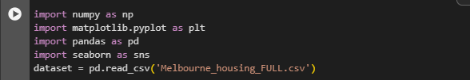
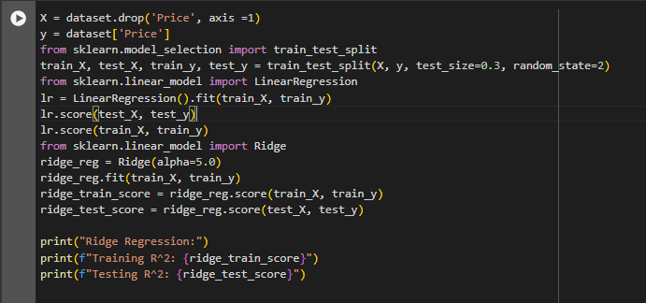
Ridge Regression

Slide 52
Lasso Regression
Lasso regression, or Least Absolute Shrinkage and Selection Operator, is a regularization method that also includes a penalty term but can set some coefficients exactly to zero, effectively selecting relevant features.
Lasso regression employs an L1 penalty, which sums the absolute values of the coefficients multiplied by lambda.
Usage: When the goal is feature selection, resulting in a simpler and more interpretable model with fewer variables

Slide 53

Lasso Regression
Formula:
$SSE_{L1}=∑_{i=1}^{n} {\left(y_{i}−{\overset{ˆ}{y}}_{i}\right)}^{2}+λ∑_{j=1}^{P} \left|β_{j}\right|$
$∑_{i=1}^{n} {\left(y_{i}−\hat{y_{i}}\right)}^{2}$ : Sum of Square errors
$λ∑_{j=1}^{P} \left|β_{j}\right|$: Regularization Term
Adds a penalty for large coefficients.
Helps to prevent overfitting by shrinking coefficients towards zero.
The regularization strength is controlled by 𝜆

Slide 54
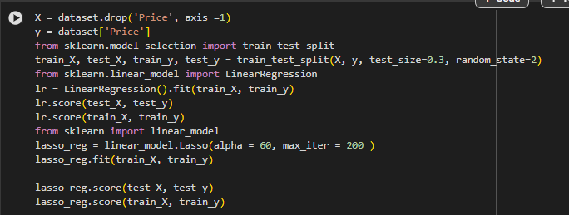
Lasso Regression

Slide 55
Classification
Logistic Regression
Support Vector Machine Classifier
Decision tree
K-Nearest Neighbors
Random Forest
Naïve Bayes Classifier

Slide 56

Logistic Regression
Logistic regression estimates the probability of an event occurring, such as voted or didn’t vote, based on a given data set of independent variables
Logistic regression is used for solving the classification problems.
Equation: $f\left(x\right)= \frac{1}{1+e^{−(β_{0}+β_{1}x+β_{2}x^{2}+…+β_{n}x^{n}) }}$

Slide 57
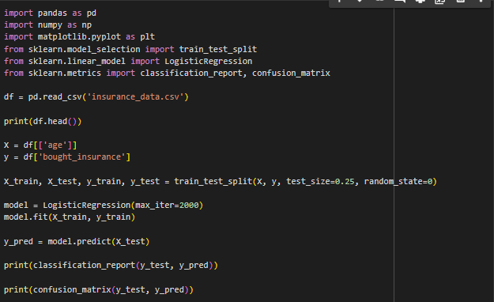
Logistic Regression
Binary Logistic Regression:

Slide 58
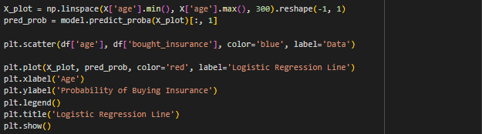
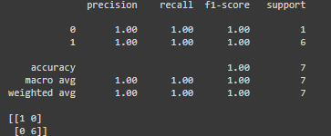
Logistic Regression
Binary Logistic Regression:
Output:

Slide 59
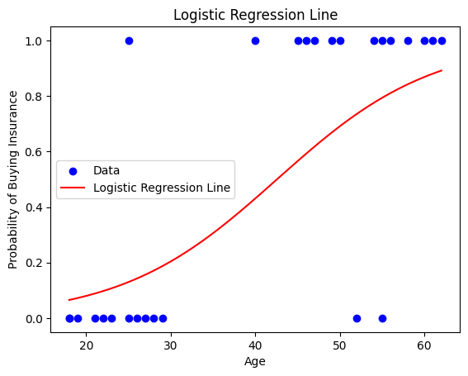
Logistic Regression
Graph

Slide 60
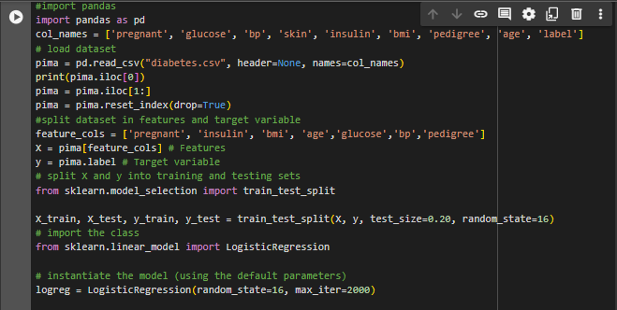
Logistic Regression
Multivariate Logistic Regression:
This type of regression is used to predict a binary outcome (0 or 1) based on multiple predictor variables

Slide 61
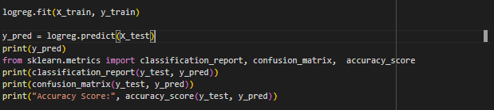
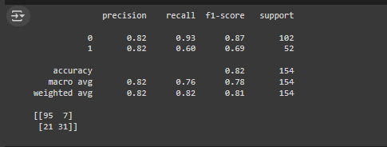

Logistic Regression
Output

Slide 62
K-Nearest Neighbor (KNN)
K-NN algorithm assumes the similarity between the new case/data and available cases and put the new case into the category that is most similar to the available categories.
K-NN algorithm at the training phase just stores the dataset and when it gets new data, then it classifies that data into a category that is much similar to the new data.

Slide 63
Working of K-NN
Select the number K of the neighbors
Calculate the Euclidean distance of K number of neighbors
Take the K nearest neighbors as per the calculated Euclidean distance.
Among these k neighbors, count the number of the data points in each category.
Assign the new data points to that category for which the number of the neighbor is maximum.
Our model is ready.

Slide 64
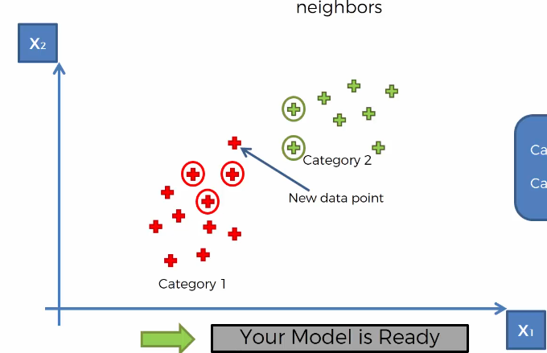
K-Nearest Neighbors

Slide 65
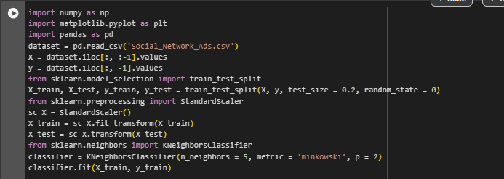

K-Nearest Neighbor (KNN)

Slide 66
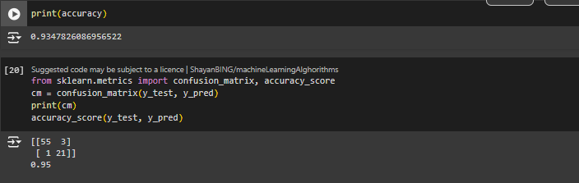
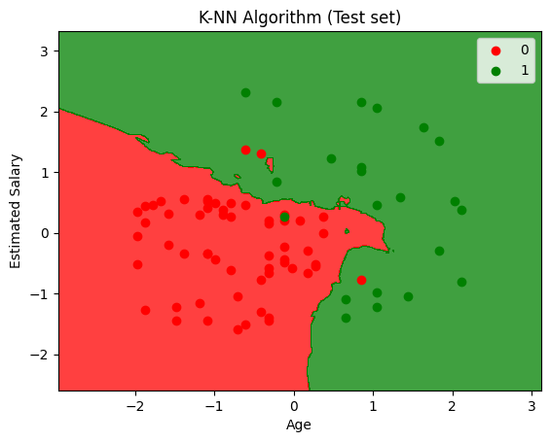
K-Nearest Neighbor (KNN)

Slide 67
Unsupervised
K- Means Clustering
Hirerchial Clustering
Principal Component Analysis (PCA)
Apriori
Eclat

Slide 68
Clustering
Grouping similar data points

Slide 69
Association

Slide 70
Slide Title
Product A
Product B
Feature 1
Feature 2
Feature 3
Feature 1
Feature 2
Feature 3

Slide 71


